Slide 1
Selenium Wait Methods

Slide 2

Selenium Method Categories
Browser Methods
WebElement Methods
Navigation Methods
Wait Methods
Switch Methods

Slide 3
Selenium Method Categories
Browser Methods are a group of methods that perform actions on a browser.
WebElement Methods are a group of methods that perform actions on WebElements.
Navigation Methods are a group of methods that either loads a web page, refresh a web page, or move backwards and forwards in your browser’s history.
Wait Methods are a group of methods that pause between execution statements.
Switch Methods are a group of methods that switch to alerts, windows, and frames.

Slide 4
Tutorial Plan
Wait Complications
Type of Wait Methods
Demo Selenium Wait Methods

Slide 5
Tutorial Plan
Wait Complications
Type of Wait Methods
Demo Selenium Wait Methods

Slide 6
Wait Complications
Server Location
Server Performance
Machine Performance
JavaScript Engine Performance

Slide 7
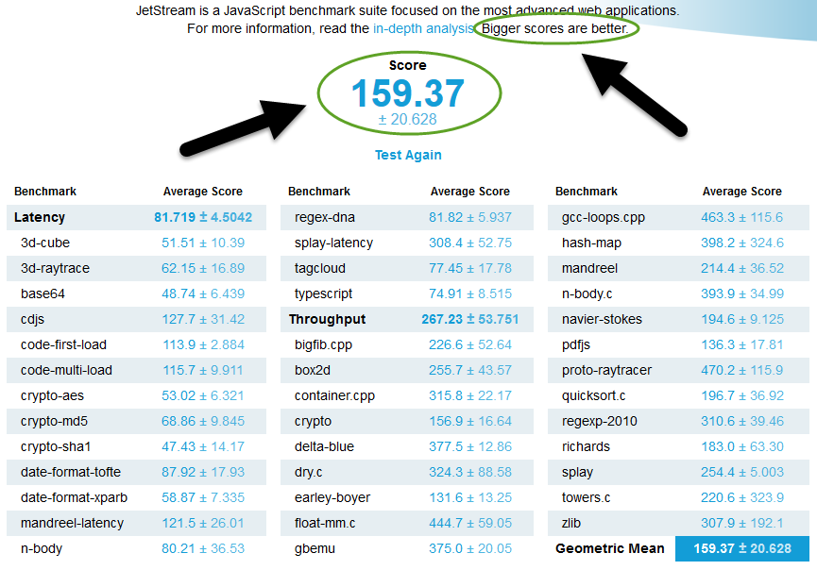
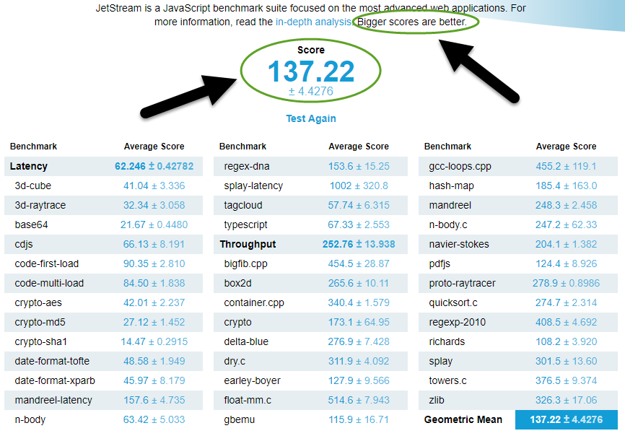
JavaScript Engine Performance
Firefox
Google Chrome

Slide 8
Tutorial Plan
Wait Complications
Type of Wait Methods
Demo Selenium Wait Methods

Slide 9
Wait Method Types
Method | Description
Thread.sleep() | (Not a Selenium Wait Method) Causes execution to sleep for a certain number of milliseconds
Page Load Timeout | Sets the wait time for a page to load before throwing an error
Set Script Timeout | Sets the wait time for JavaScript to execute before throwing an error
Implicit Wait | Determines the wait time to search for an element before throwing an exception
Explicit Wait | Pauses execution until time has expired or an expected condition is met via WebDriverWait class
Fluent Wait | A specialization of Explicit Wait that’s extended by the WebDriverWait class

Slide 10
Tutorial Plan
Wait Complications
Type of Wait Methods
Demo Selenium Wait Methods

Slide 11
Wait Methods
Page Load Timeout
Implicit Wait
Explicit Wait
Fluent Wait

Slide 12
Wait Methods
Page Load Timeout
Implicit Wait
Explicit Wait
Fluent Wait

Slide 13
Wait Methods
Page Load Timeout
Implicit Wait
Explicit Wait
Fluent Wait

Slide 14
Implicit Wait vs Explicit Wait
Implicit Wait | Explicit Wait
Single Code Line | Multiple Code Lines
Used On All WebElements | Used For A Specific WebElement
Expected Conditions Are Not Required | Expected Conditions Are Required

Slide 15
Expected Conditions
alertIsPresent() | textToBePresentInElementLocated()
elementSelectionStateToBe() | textToBePresentInElementValue()
elementToBeClickable() | titleIs()
invisibilityOfTheElementLocated() | titleContains()
invisibilityOfElementWithText() | visibilityOf()
presenceOfAllElementsLocatedBy() | visibilityOfAllElements()
presenceOfElementLocated() | visibilityOfAllElementsLocatedBy()
textToBePresentInElement() | visibilityOfElementLocated()

Slide 16
Wait Methods
Page Load Timeout
Implicit Wait
Explicit Wait
Fluent Wait

